Slide 1
Biotic and Abiotic Factors

Slide 2
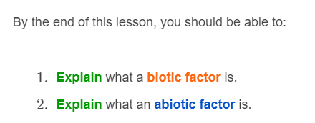


Slide 3

An ecosystem is the interaction between abiotic and biotic factors.
Biotic factors are all of the living things within an ecosystem.
Abiotic factors are all of the non-living things in an ecosystem.

Slide 4


Slide 5
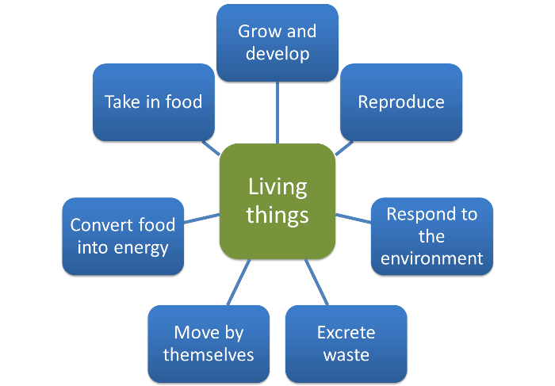
A biotic factor is a living factor.
It includes things like bacteria, viruses, fungi, plants, and animals.
Biotic factors include anything that has the ability to carry out these seven life processes:

Slide 6

Abiotic factors are the non-living parts of an ecosystem.
These include physical and chemical factors, such as temperature, rainfall, soil type and water salinity.

Slide 7
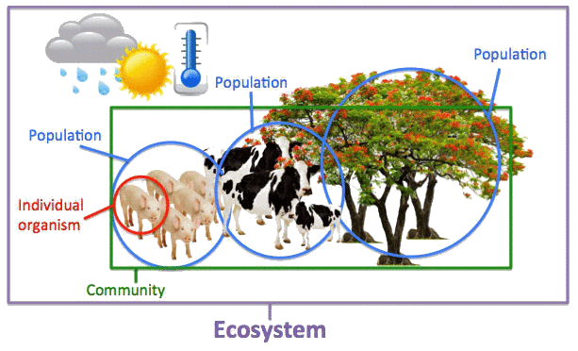
The biotic factors are all the living things in an ecosystem. In the above picture, these are the pigs, the cows and the trees.
The abiotic factors are all the non-living things in an ecosystem. In the above picture these are the temperature and weather.

